Slide 1
Clean Code
By Robert Martin
Presented by Ivan Pavlov

Slide 2
What is Clean code? Why should we strive for it?

Slide 3
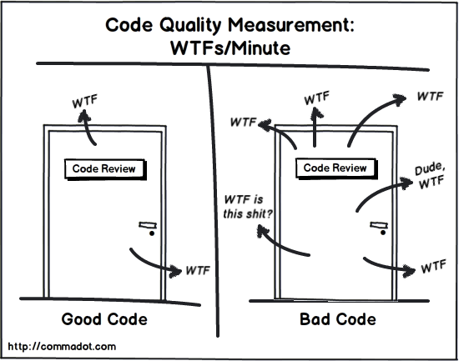
WTF’S Per minute

Slide 4
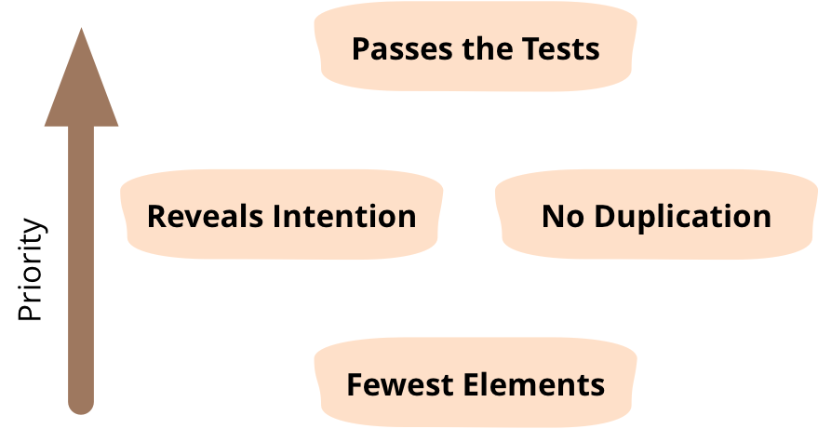
Kent Beck’s rules of software design

Slide 5
Naming conventions
“Well written Prose”
Use intention revealing names
Names should at least be pronounceable and searchable
Names should be consistent
Avoid disinformation
Avoid abbreviations
Consistency in naming

Slide 6
Naming examples
Classes should be nouns :
Customer, WikiPage, Account, OrderDetails
Functions should be verbs :
SearchProduct(), SendTransaction(), EnlargeLink()
Boolean names should answer yes or no:
areHostsValid(), isGoldClient()

Slide 7
Naming examples
Intention revealing names:
“int elapsedTimeInDays;” is better than “int d;”
Pronounceable names:
class DtaRcrd102 {
private Date genymdhms;
private Date modymdhms;
class Customer {
private Date generationTimestamp;
private Date modificationTimestamp;

Slide 8
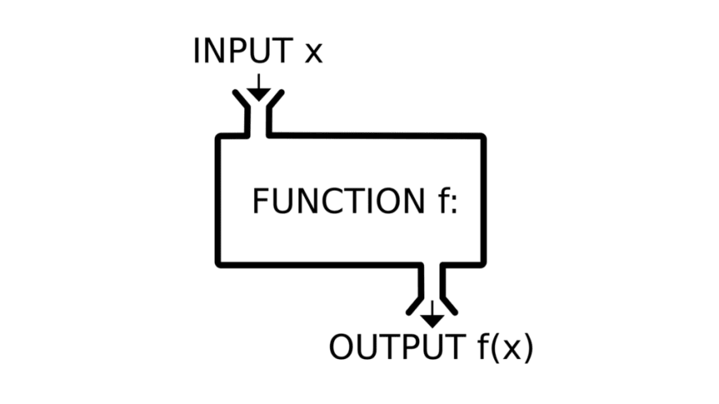
Functions

Slide 9
Function conventions
Functions should do one thing well, and one thing only
Functions should be SMALL
Avoid the too many parameters, if they become more than 6 (+-2)
consider splitting it into another function (class)
Don’t make GOD functions, if you stumble upon one, refactor it

Slide 10
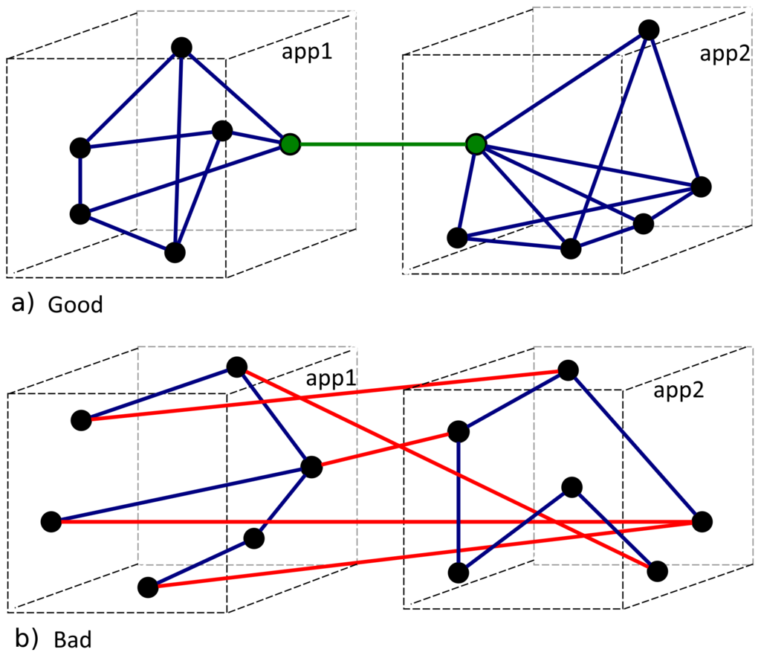
Cohesion and coupling

Slide 11

Function examples
Unacceptable Cohesion
• Unrelated (random) operations are grouped in a method for unclear reason
• Incorrect example:
HandleStuff(customerId, int[], ref sqrtValue, mp3FileName, emailAddress) {};
• Does too many things, badly written function!

Slide 12

Function examples
Acceptable Cohesion
Math.Sqrt(value) -> square root
Char.IsLetterOrDigit (char)
String.Substring(str, startIndex, length)
SendEmail(recipient, subject, body)
Connect to mail server
Send message headers
Send message body
Disconect from server

Slide 13
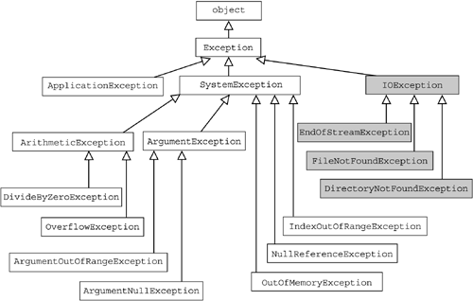
Classes

Slide 14
Class conventions
Good utilization of OOP principles
Classes should be small, and use the single responsibility principle
Strong cohesion is very important, as is loose coupling
SOLID Principles are very important for proper class structure
Group related methods into a single class
Does the class name correspond to the class content?

Slide 15
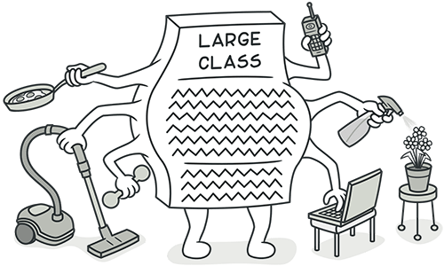
Class example
God class

Slide 16

Class examples
Class Employee
{
public string FirstName { get; set; }
public string LastName { get; set; }
…
public SqlCommand FindByPrimaryKeySqlCommand (int id) {};
}
FindByPrimaryKeySqlCommand is inconsistent with the abstraction of
the class, it is unnecessary and should be moved to a separate class

Slide 17
Class examples
<?php
class Person
{
public $prefix;
public $givenName;
public $familyName;
public $suffix;
}
$person = new Person();
$person ->prefix = “Mr. “;
$person ->givenName = “John”;
echo($person -> prefix);
echo($person -> givenName);
?>

Slide 18
Class examples
<?php
class Person
{
private $prefix;
private $givenName;
private $familyName;
private $suffix;
}
public function setPrefix($prefix)
{
$this->prefix = $prefix;
}
public function getPrefix()
{
return $this->prefix;
}
…………

Slide 19
Class examples
<?php
class DBPersonProvider
{
public function getPerson($givenName, $familyName)
{
/* go to the database, get the person... */
$person = new Person();
$person->setPrefix("Mr.");
$person->setGivenName("John");
return $person;
}
}
/* I need to get person data... */
$provider = new DBPersonProvider();
$person = $provider->getPerson("John", "Doe");
echo($person->getPrefix());
echo($person->getGivenName());

Slide 20
Class examples
<?php
interface PersonProvider
{
public function getPerson($givenName, $familyName);
}
class DBPersonProvider implements PersonProvider
{
public function getPerson($givenName, $familyName)
{
/* pretend to go to the database, get the person... */
$person = new Person();
$person->setPrefix("Mr.");
$person->setGivenName("John");
return $person;
}
}

Slide 21
Class examples
class PersonProviderFactory
{
public static function createProvider($type)
{
if ($type == 'database’) {
return new DBPersonProvider();
} else {
return new NullProvider();
}
}
}
$config = 'database';
/* I need to get person data... */
$provider = PersonProviderFactory::createProvider($config);
$person = $provider->getPerson("John", "Doe");
…….

Slide 22
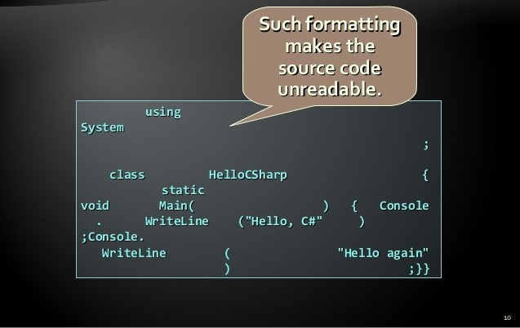
Formatting

Slide 23
Formatting conventions
Good formatting goals :
To improve code readability
To improve code maintainability
Fundamental principle of code formatting
The formatting of the source code should disclose its logical structure
Use automated tools and take advantage of your IDE or text editor

Slide 24

Commenting and documentation

Slide 25
Effective comments
Effective comments do not repeat the code
The best documentation is the source code itself – keep it readable
Comment anything that gets around an error or undocumented feature
Paragraph comments should explain why rather than the how

Slide 26
Guidelines for proper documentation
Describe the design approach to the class
Describe limitations, usage assumptions, and so on
Describe the purpose and contents of each file
Give the file a name related to its contents

Slide 27

Unit Tests

Slide 28
Unit testing
The three laws of TDD
Write a failing test : You may not write production code until you have written a failing unit test.
Make the test pass: You may not write more of a unit test than is sufficient to fail, and not compiling is failing
Refactor as necessary: You may not write more production code than is sufficient to pass the currently failing test

Slide 29
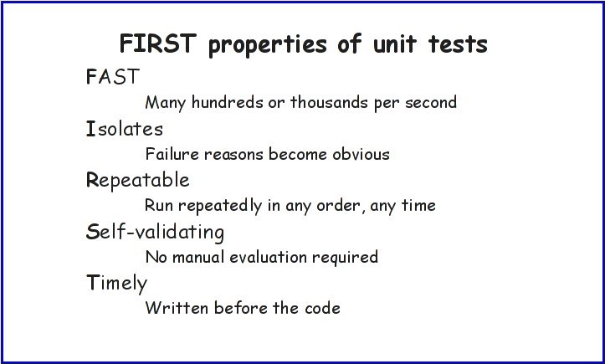
F.I.R.S.T.

Slide 30


